Slide 1
Restoring and Protecting Commons
Through MGNREGA
for Nature and People
Bandana Sambyal
Foundation For Ecological Security (FES)

Slide 2
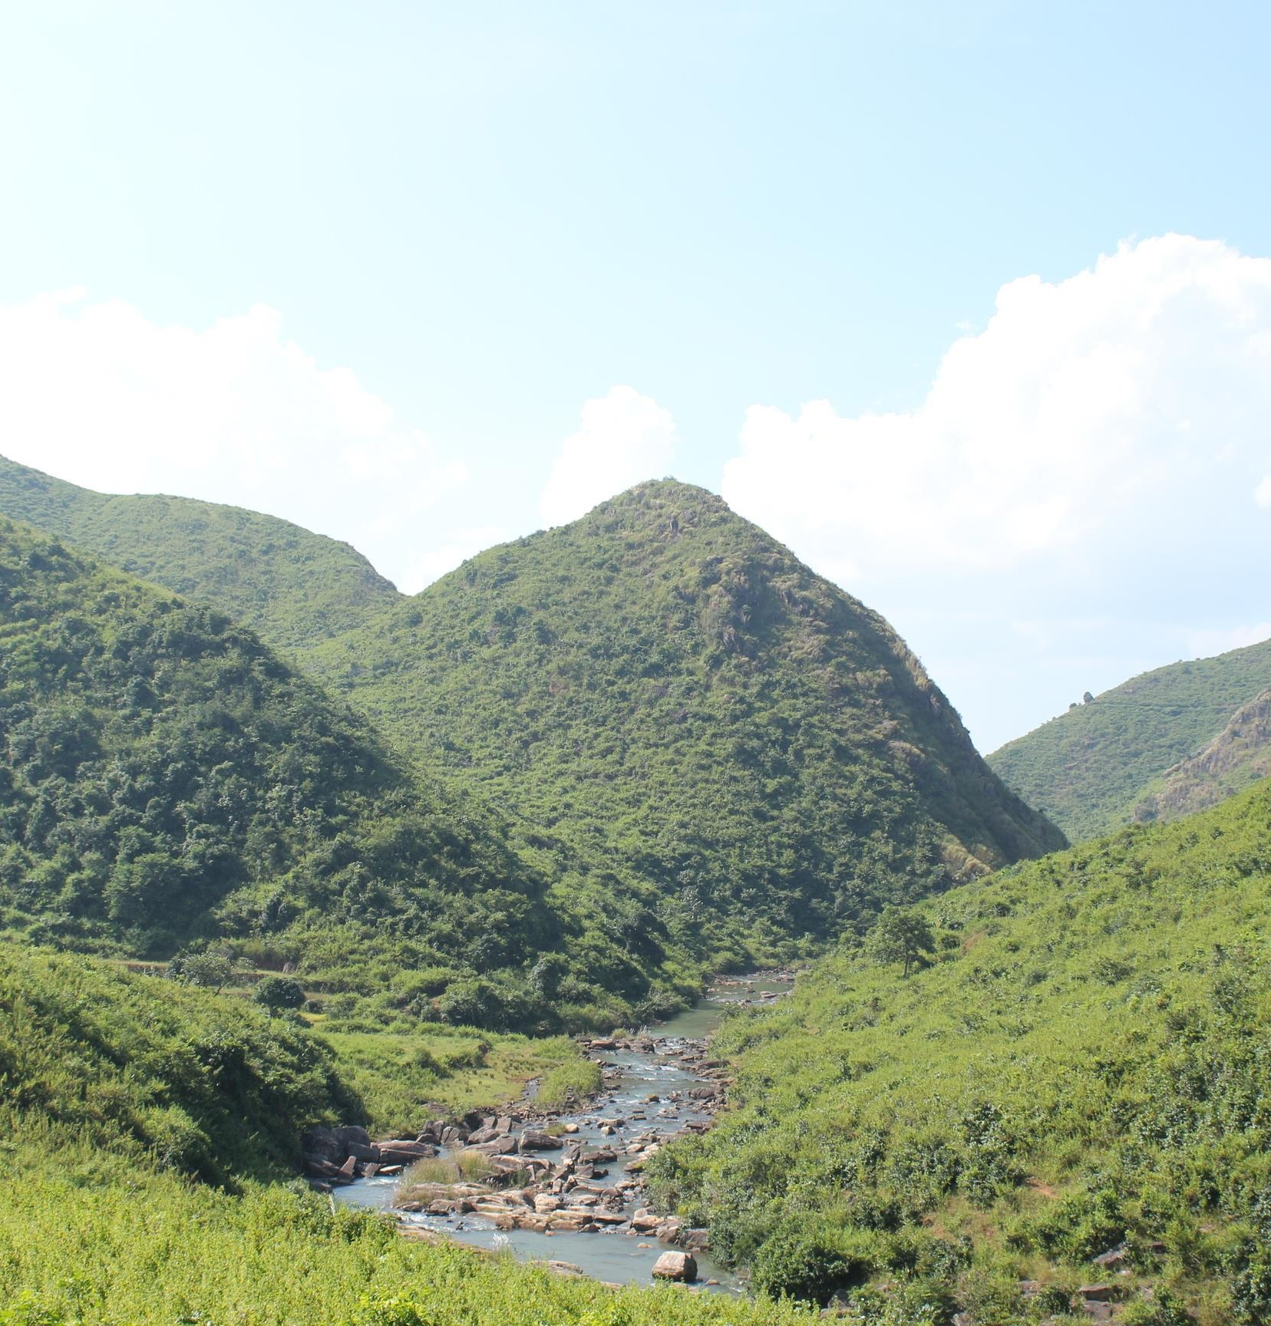

Slide 3
•
•
•
•

Slide 4
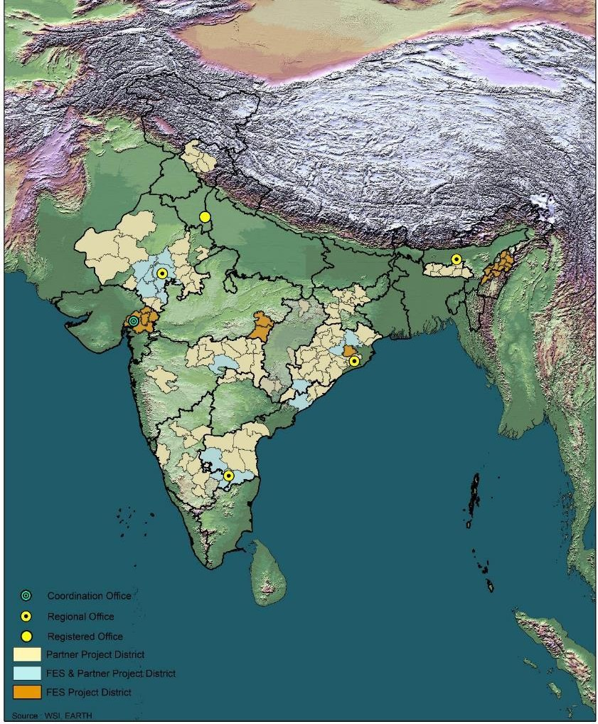
•
•
•
•
•
•

Slide 5
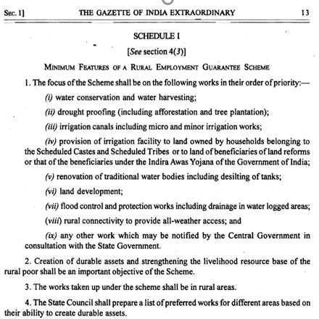

Slide 6
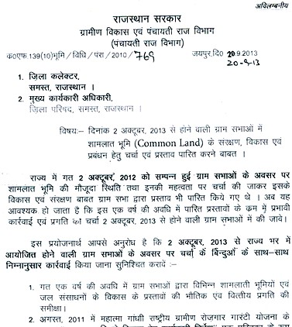
⚬
⚬
⚬
⚬
⚬
⚬
•
Drafted common land policy in Rajasthan

Slide 7
Various government orders for development of Pastureland
Including Pastureland development work in gram sabha on priority bases
65% NRM work sanction Pastureland development work and water conservation on priority
90% work in PD estimate is labour part provide employment to the villagers
Shamlat abhiyan campaign by government to take it forward .
3 tier institutional arrangement for governance of these pasturelands .
Banjar bhoomi development board was formed to develop these pasturelands .
Working on public –private partnership model

Slide 8
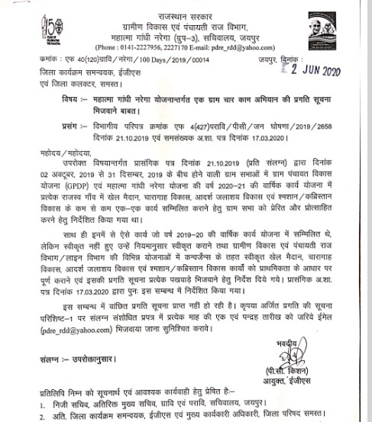
ˢᵗ
⚬
⚬
⚬
⚬

Slide 9
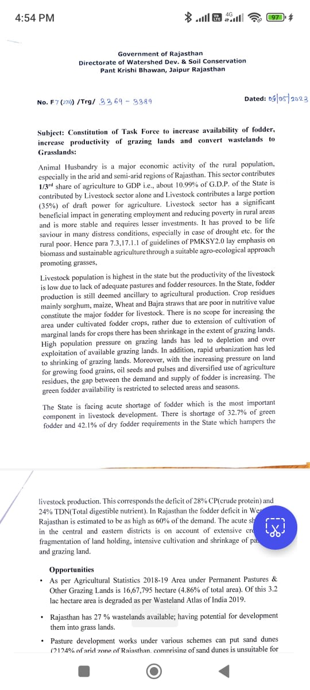
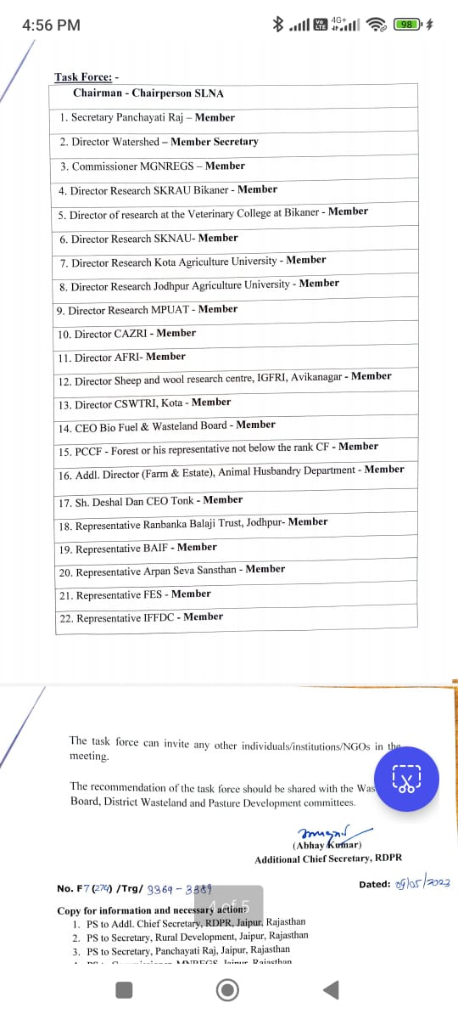
Proactive government innovative initiatives for development of Pastureland
Formation of Empowered Task force at the State level including departments, Research institutions, academic universities and civil society organisations.
Engagement of Rajeevika (State Livelihood mission) with pastureland development. Possibility of non timber forest produce like grass and tree seeds, fruits, nursery, gum, etc.
Issuance of enabling orders before 2nd October Gram sabhas. Advisory to demarcate and secure the land, restoration measures, protection, etc

Slide 10
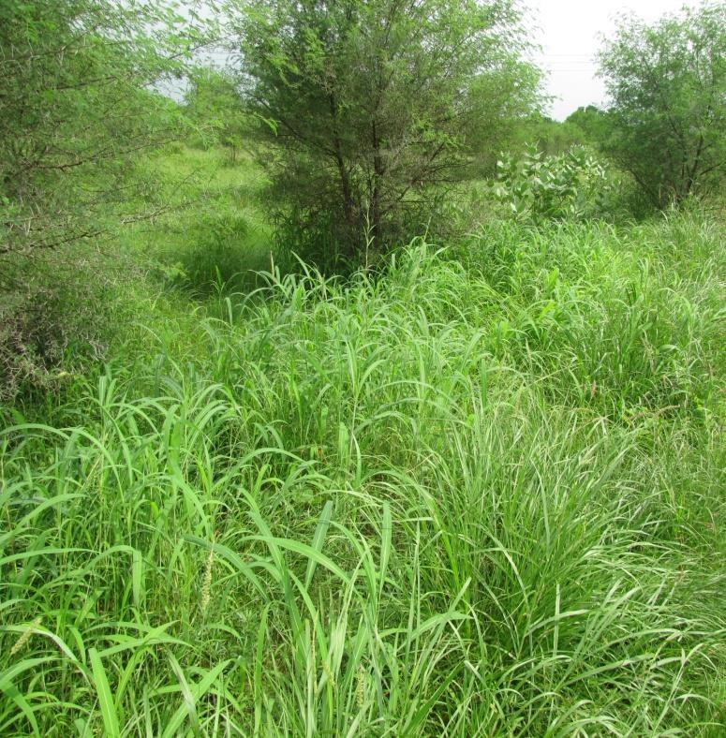
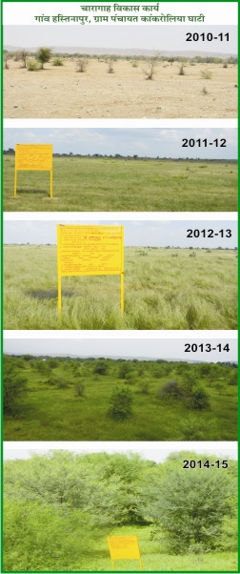
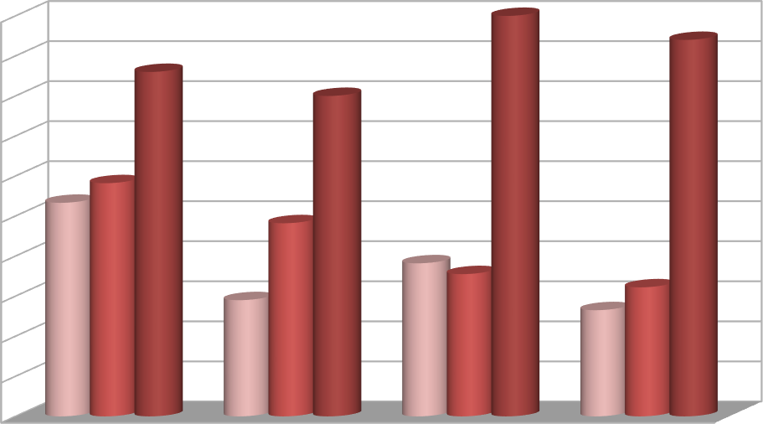
Change in Green (Grasses and herbs) biomass (tones/ha.)
Village | 2013-14 | 2019-20 | 2021-22
Gandheri | 0.25 | 2.82 | 3.85
Pandheri | 0.9 | 2.66 | 4.3
Goga ka kheda | 0.82 | 3.55 | 4.85
Hastinapur | 0.65 | 3.22 | 3.4
Village institution name – Chargha vikas
samiti, Hastinapur
Year of initiation ;- 2011-12
Total HH – 110
Total animal population 230
Total Pastureland 35 ha
Community governance ;- Kulhadi bandi ,rotational protection , sharmdan,
Change in Green (Grasses and Herbs) Biomass (tonnes/ha.)
10
9
8
7
6
5
4
3
2
1
0
Biomass (tonnes/ha.)
2013-14
2014-15
2015-16
Gandheri Pandheri
Gurjar ka kheda
Hastinapur

Slide 12
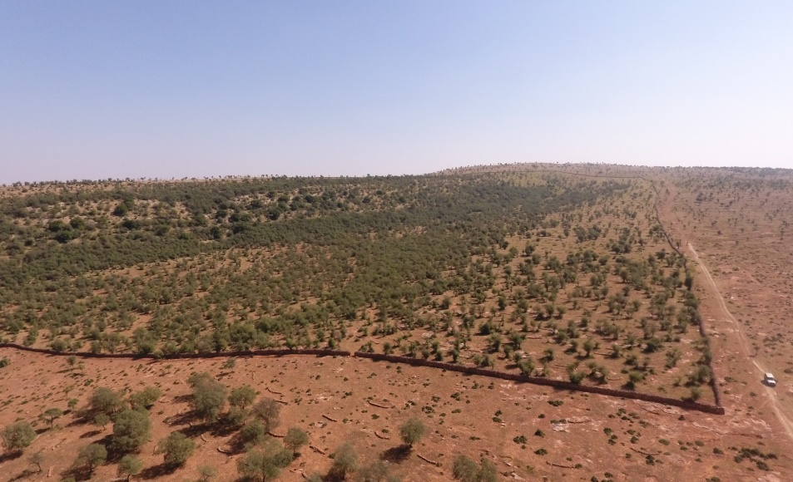
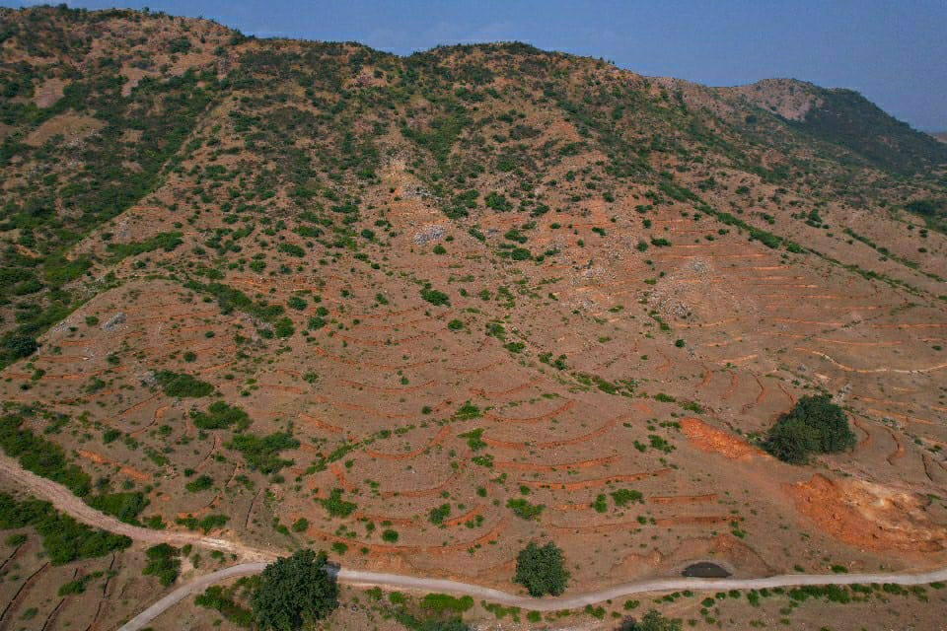
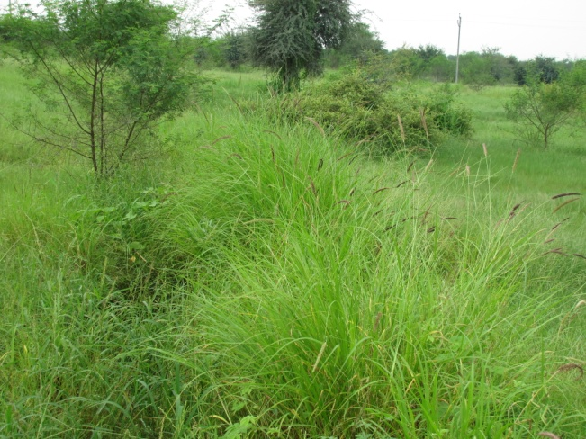
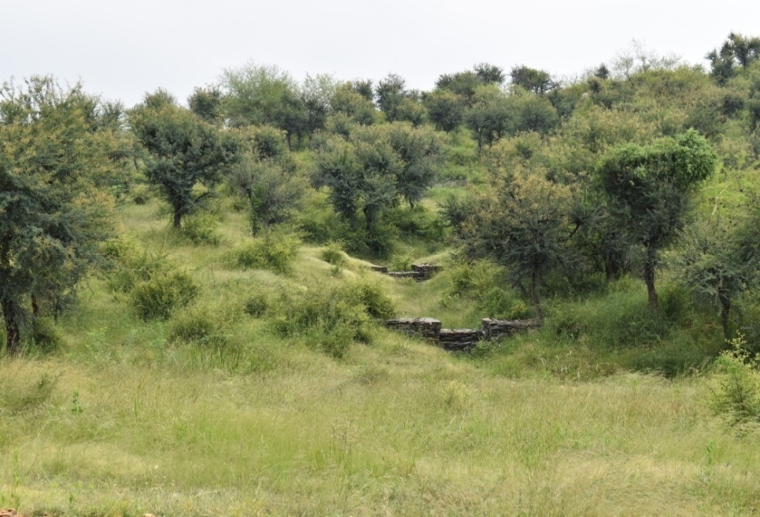
Case study - Kekeriya
Meeting / Decentralised Planning with community
Type of land : ( Pastureland / Forest / Revenue waste land
Under Legal framework they form three types of institutions
Chargah vikas samiti- Managing Pasture land
Village Forest Protection Management VFPMC- Managing forest land
Tree Growers Cooperative society (TGCS): Managing revenue land
Managing commons both Land and water commons to strengthen the local natural resources: Improving Fodder, Enhance water conservation, Augment local livelihoods, Improve Bio diversity and ecological health.

Slide 13
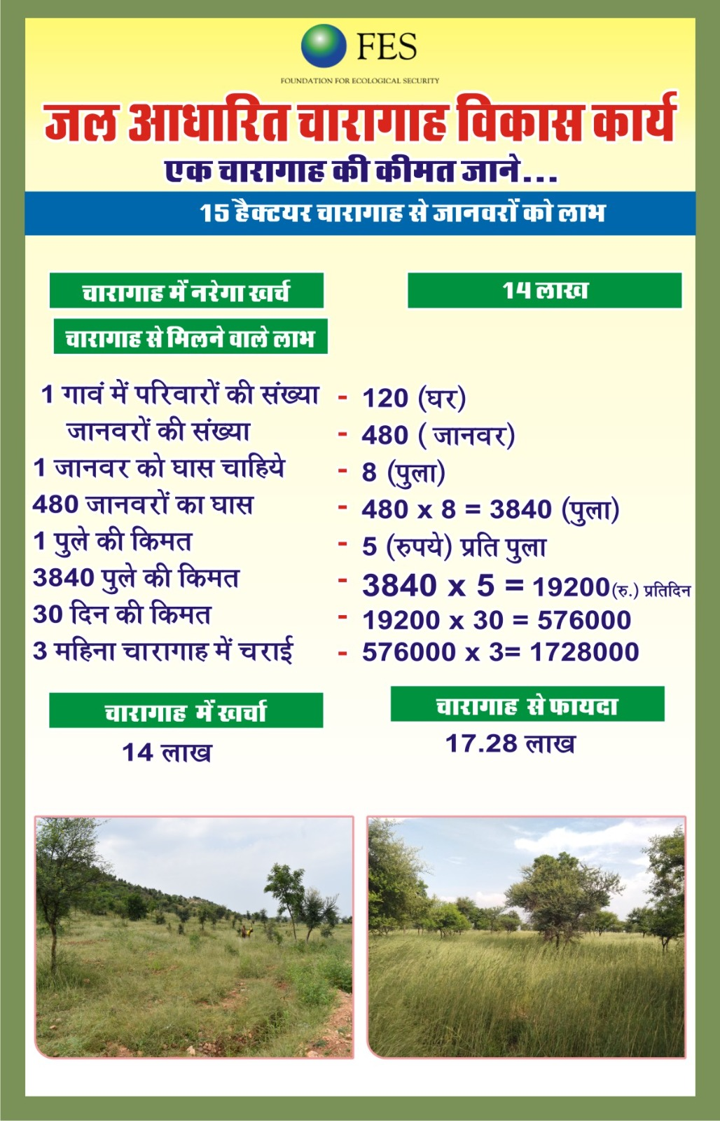
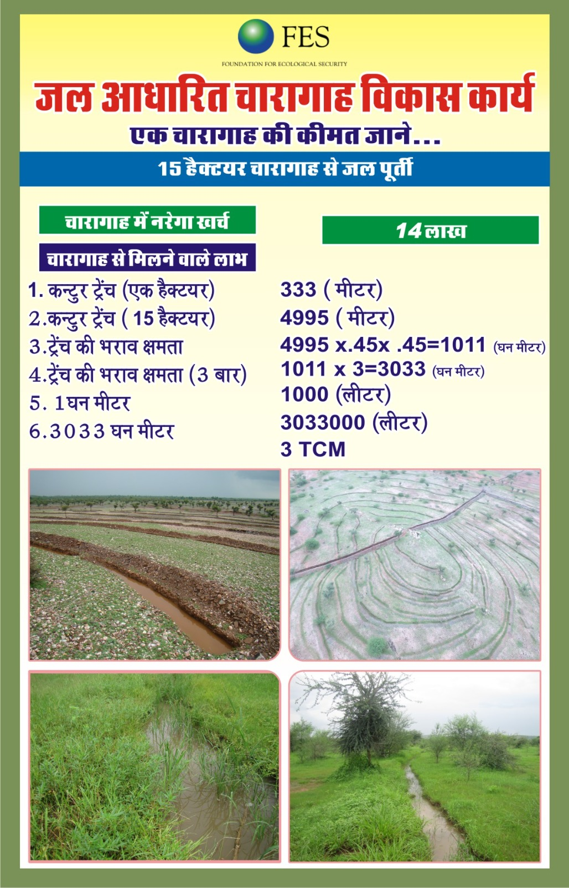

Slide 14
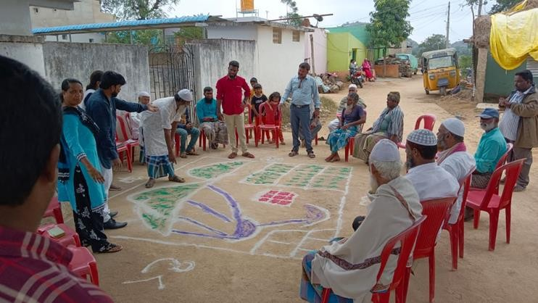
•
•
•
•
•
•
•

Slide 16
Glimpses of MGNREGA works

Slide 17
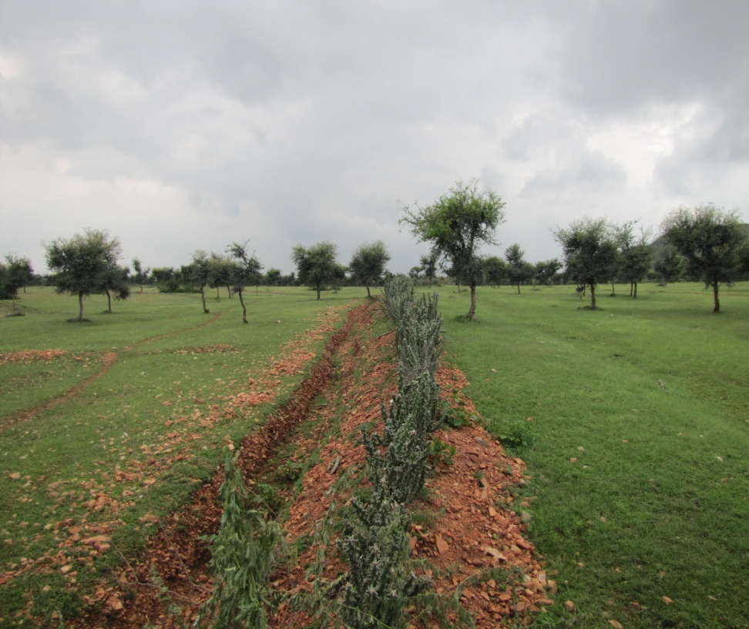
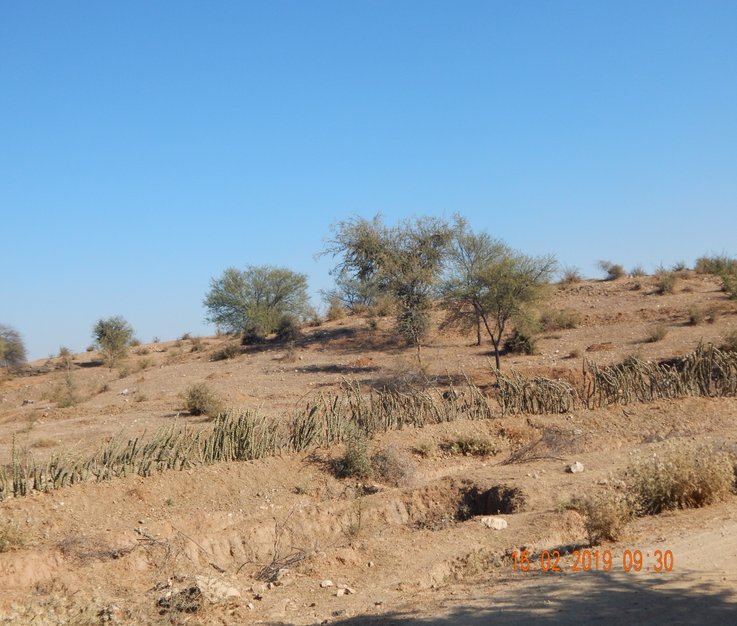
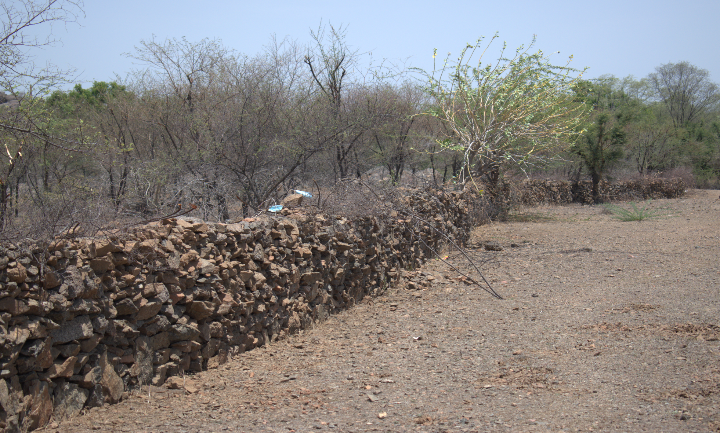
Cattle protection trench, Vegetative fence & Stone wall

Slide 18
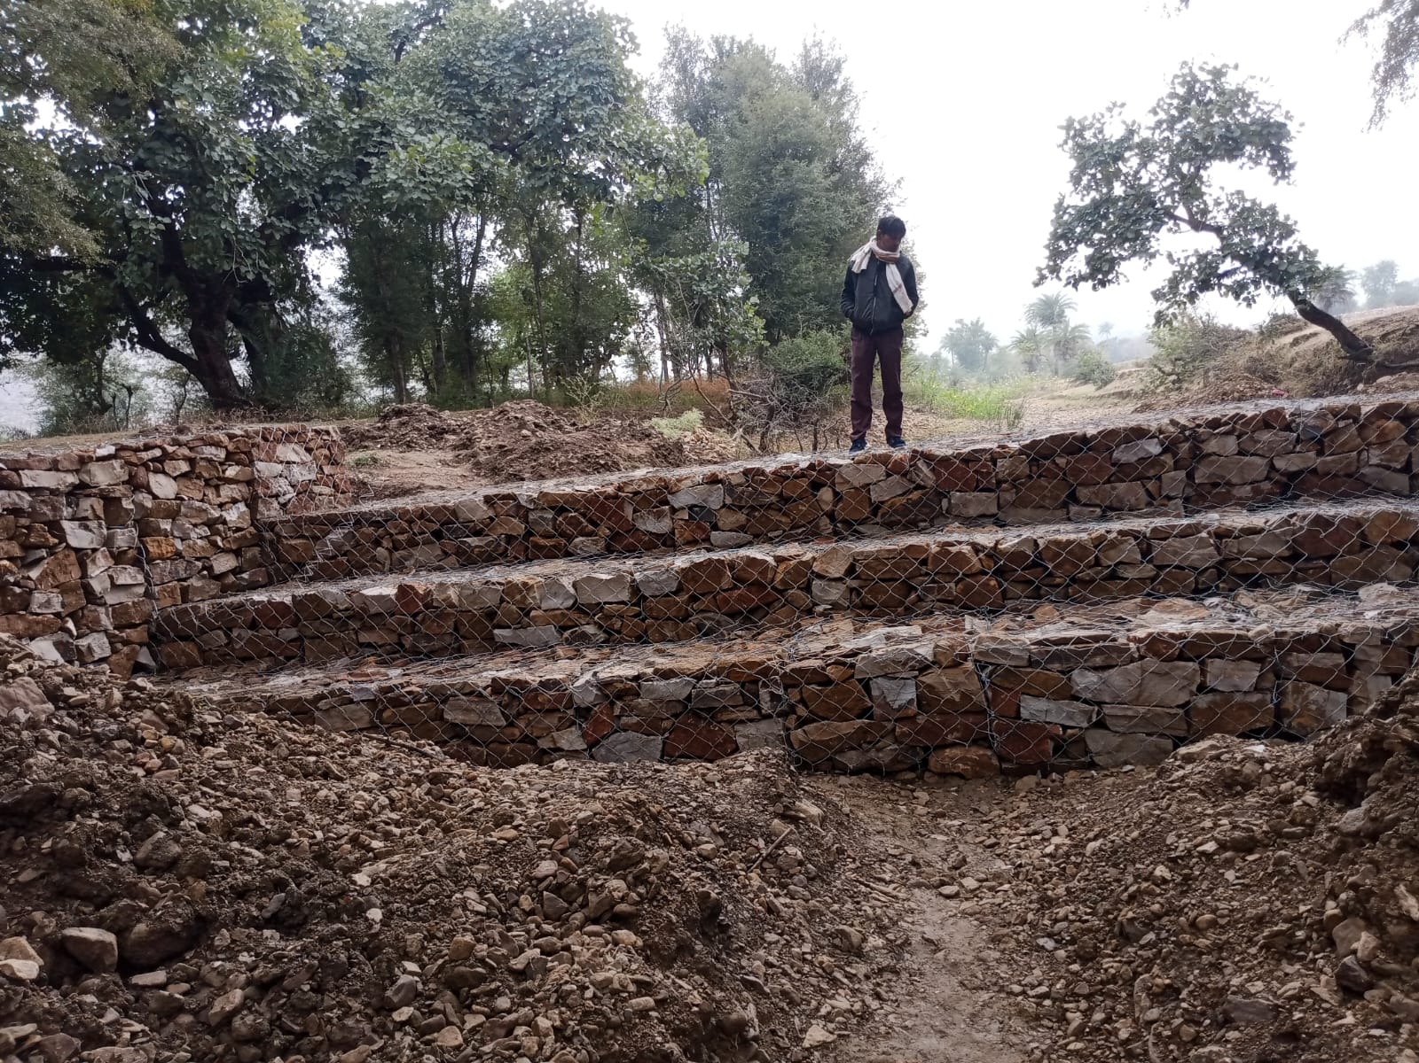
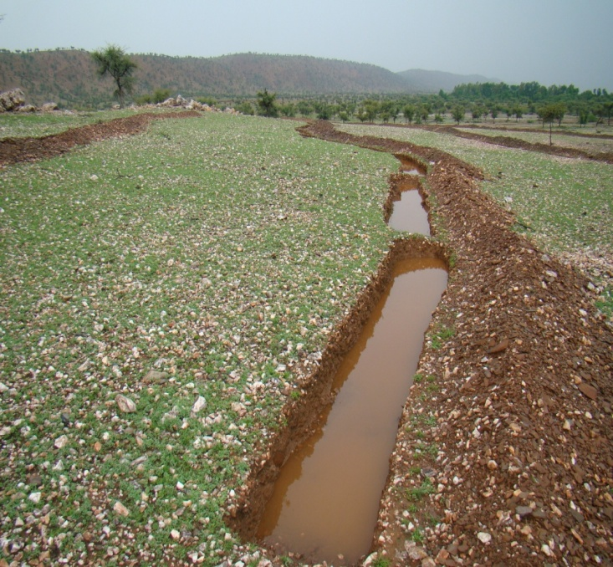
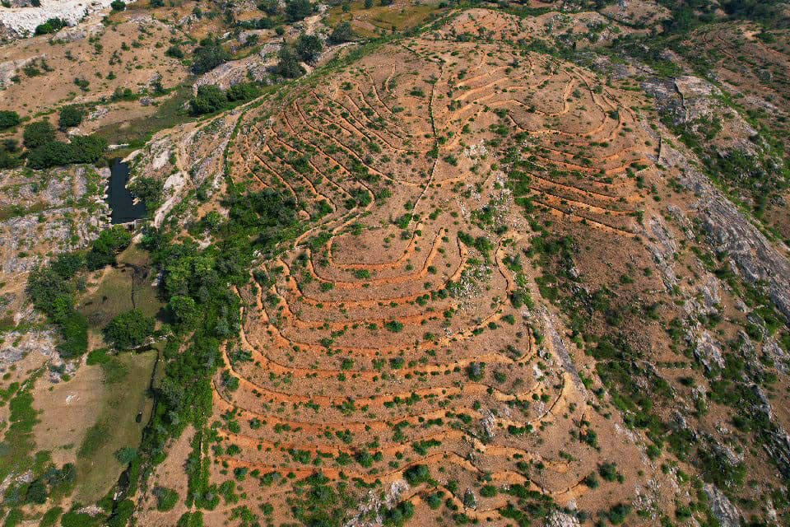
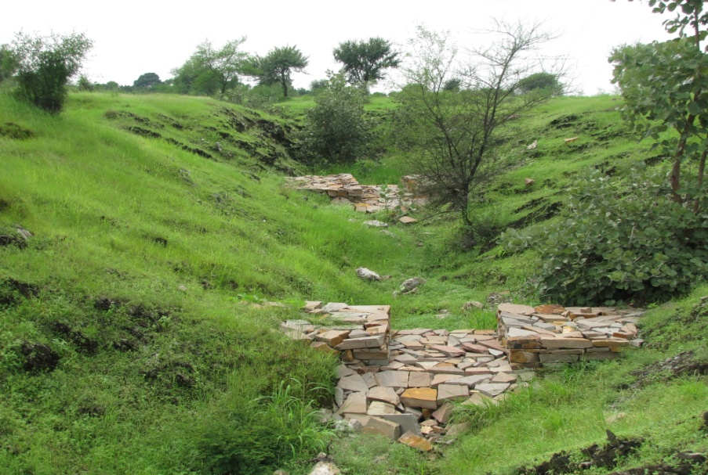
Soil moisture conservation initiatives
1.Contour trench
2.Loose boulder check dams
3. Gabion

Slide 19
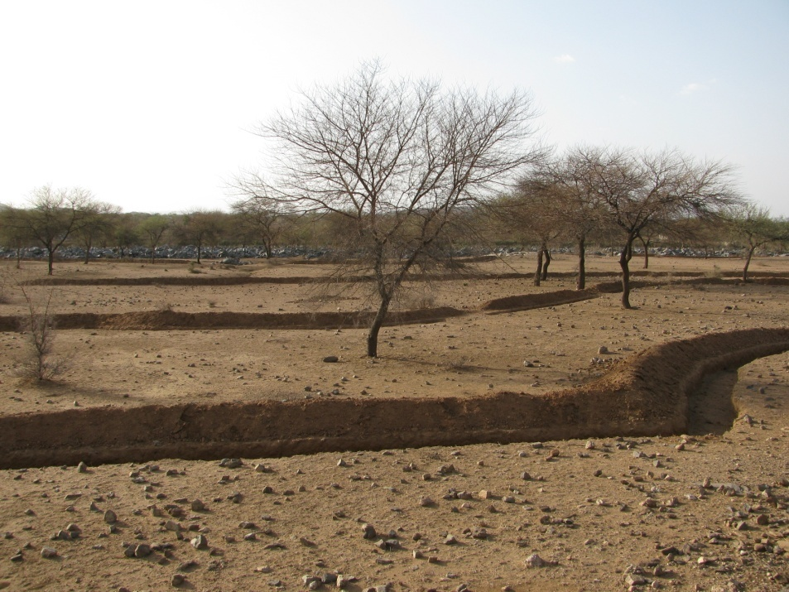
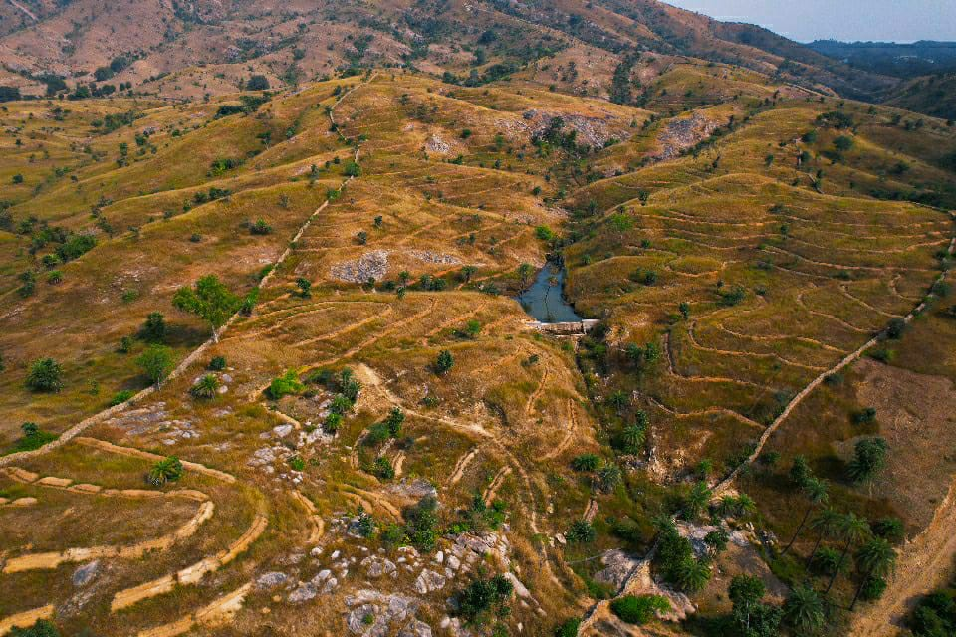

Slide 20
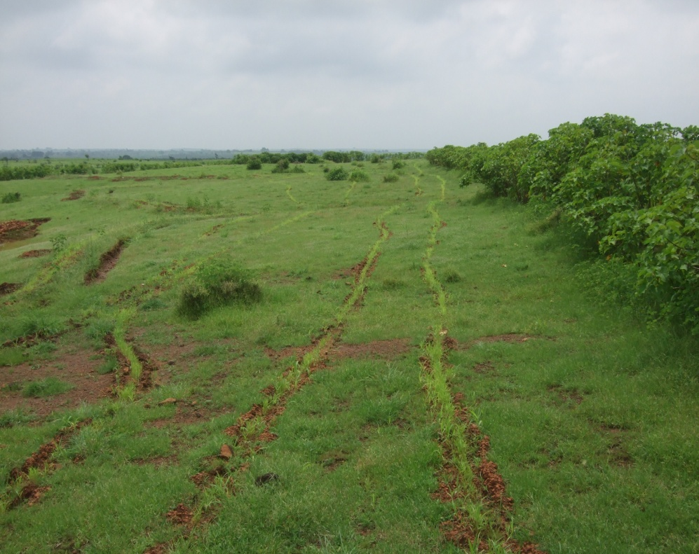
Grass seeding & Plantation along with soil moisture conservation

Slide 21
Low cost loose boulder checks
Improves sub-surface flow, nutrient cycle

Slide 22
Low cost water harvesting structures under MGNREGA

Slide 24
Grass seed collection

Slide 25
Impact of Regeneration work done through community governance
Before
After

Slide 26
Impact of Regeneration work
Before
After

Slide 27
Community managed commons in Barundani village Mandalgarh

Slide 28
Before
Udaipur
After

Slide 30
Cartoons for awareness campaign

Slide 31
Thank you

